Slide 1
CS 4310: Software Engineering
Lecture 3
Requirements and Design

Slide 2
Requirements and design
In principle, requirements should state what the system should do and the design should describe how it does this.
In practice, requirements and design are inseparable

Slide 3
The Requirements Document
The requirements document is the official statement of what is required of the system developers
Should include both a definition and a specification of requirements
It is NOT a design document. As far as possible, it should set of WHAT the system should do rather than HOW it should do it

Slide 4
The IEEE Standard
1. Introduction
1.1. Purpose
1.2. Scope
1.3. Definitions, acronyms
1.4. References
1.5. Overview
2. Overall description
2.1. Product perspective
2.2. Product functions
2.3. User characteristics
3. Specific requirements
3.1 User Requirements
3.2 System Architecture
3.3 System Requirements
4. Legal, Copyright and Other Notices
5. System Evolution
6. Supporting info.
Appendix A, ..

Slide 5
Types of Requirements
Requirements set out what the system should do and define constraints on its operation and implementation
Functional requirements set out services the system should provide. These are mandatory for system functionality.
Non-functional requirements constrain the system being developed and specifies non-functional characteristics.
User requirements are high-level statements of what the system should do

Slide 6
The Design Document
The Requirements Document states WHAT the system should do.
The Design Document states HOW the system should do this.

Slide 7
Stages in Design Analysis
Example: University Admissions System
• Applicants
• University administration
Admissions office and Financial aid office
Special offices (e.g., athletics, development)
• Computing staff
Operations
Software development and maintenance
• Academic departments

Slide 8
Start with Requirements
Step 1: Organize the requirements:
• Gather a list of requirements and create a Requirements Document.
Step 2: Perform design analysis:
Take the Requirements Document and perform Design Analysis in order to create the Analysis and Design Documentation.

Slide 9
Begin Design Analysis
Design Analysis Models the requirements:
Common modeling techniques are:
  Procedural models
  Data-centric models
  Object-Oriented models
  Formal models

Slide 10
Procedural Models Example
- Flowchart -
Operation
Decision
Manual operation
Report

Slide 11
Flowchart Example:
A University Admissions System
Form received
F
Update database
T
New?
Complete?
T
F
Evaluate
Notify student
Database record
Notify student

Slide 12
Procedural Model Example:
- Pseudo-code -
Example Pseudo Code:
check_plan (report)
if report (date_time) > due_date_time then error (too_late)
if report (client) = none then error (no_client)
if report (team) < min_team or > max_team
then error (bad_team)
if error() = none
then comments = read_report (report)
return (comments (text), comments (grade))
else return error()

Slide 13
Procedural Model Example:
- Data-Flow Models -
External entities
Processing steps
Data stores or sources
Data flows

Slide 14
Example Data Flow Diagram: University Admissions
Rejection
Application
form
Completed
application
Receive
application
Evaluate
Applicant
Offer

Slide 15
Example 2: University Admissions
Assemble Application Stage
Acknowledgment
Acknowledgment
Application
form
Completed
application
AND
Evaluation
request
Receive
Initiate
evaluation
Applicant
AND
Supporting
information
Pending
database
Applicant
database

Slide 16
Example 2: University Admissions
Process Completed Application Stage
Rejection
Evaluation
request
Acceptance
Offer
Financial
aid
Evaluation
Special
request
Applicant
database

Slide 17
Requirements Analysis v. System Design
• Requirements analysis should make minimal assumptions about the system design.
• But the requirements definition must be consistent with computing technology and the resources available.
In practice, analysis and design are interwoven.

Slide 18
Requirements & Design
Scenario Planning
Create Scenarios which are descriptions of how a system is used in practice
Scenarios are helpful in requirements elicitation as people can relate to these more readily than abstract statement of what they require from a system
Scenarios are particularly useful for adding detail to an outline requirements description

Slide 19
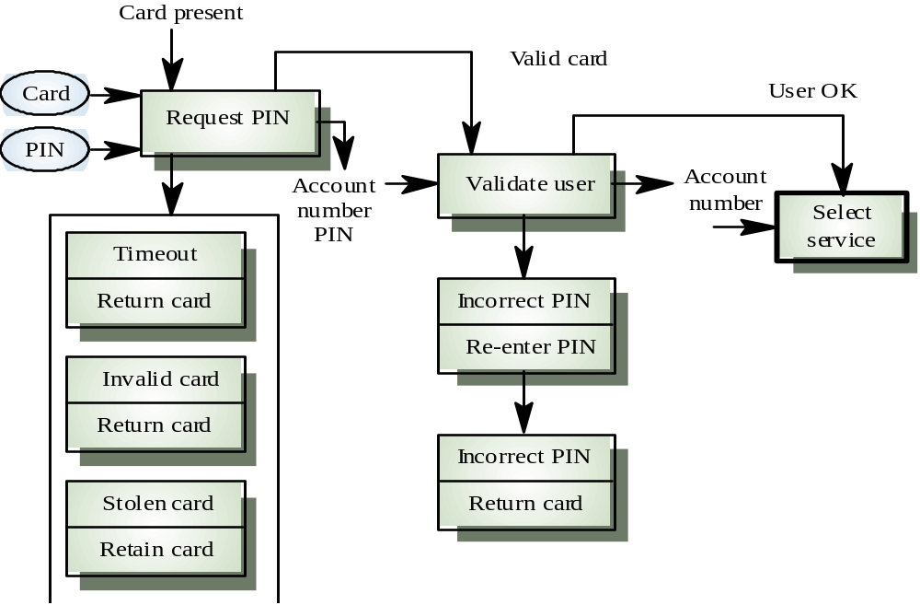
Scenario Example: ATM System

Slide 20
Introduction to Use Cases
Use-cases are a scenario based technique in UML (Unified Modelling Language) which identify the actors in an interaction and which describe the interaction itself
A set of use cases should describe all possible interactions with the system
Sequence diagrams may be used to add detail to use-cases by showing the sequence of event processing in the system

Slide 21
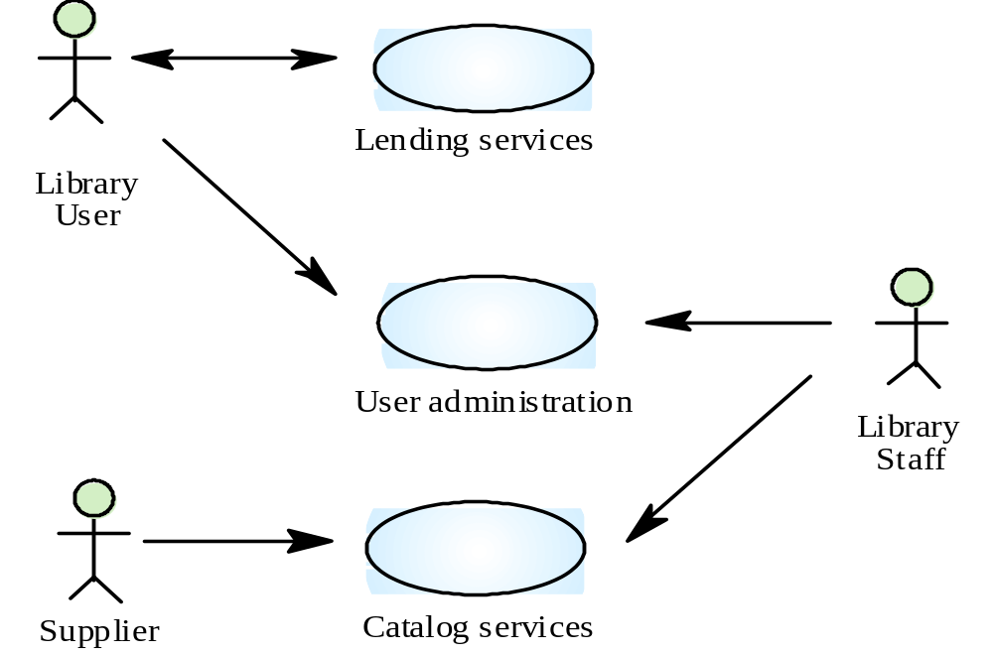
A Library System: Use-Cases

Slide 22
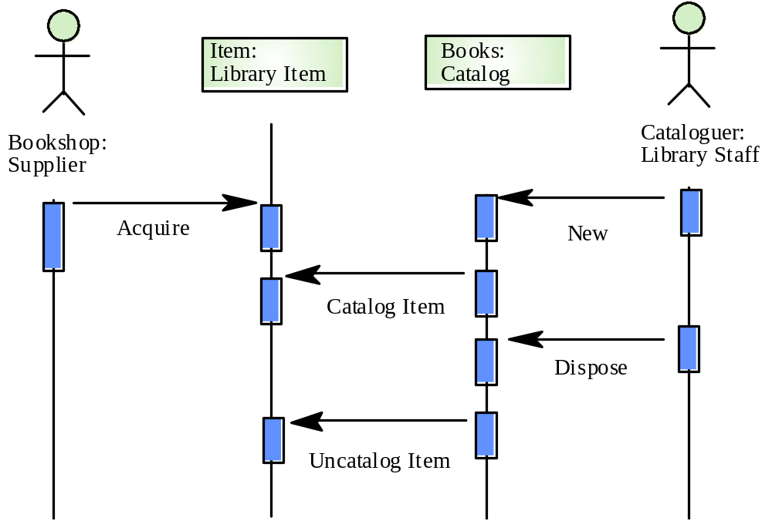
Catalogue Management: Use Cases

Slide 23
What’s after Requirements?
System Development Stage
Next two project deliverables:
Analysis Document
    Contains system models/diagrams/flow charts
Design Document
    Contains the blue-print for the system design implementation.

Slide 24
Project Work
Develop a list of requirements for your system.
Outline and/or think about system usage scenarios.
Begin the process of system design analysis.

